Slide 1
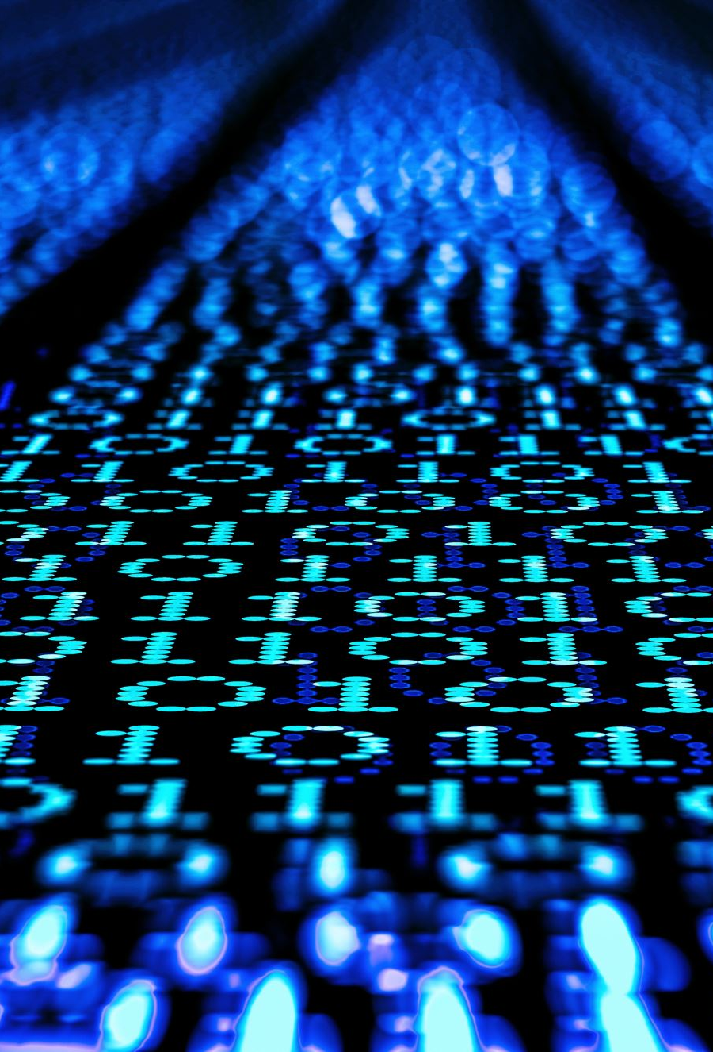
Python Scikit-Learn
Data Analytics Department
Bridgerland Technical College

Slide 2
Scikit-learn
A library in Python

Slide 3
Scikit-learn
A library in Python
Implements a range of machine learning, preprocessing, cross-validation and visualization algorithms using a unified interface(1)

Slide 4
Scikit-learn
A library in Python
Implements a range of machine learning, preprocessing, cross-validation and visualization algorithms using a unified interface(1)
Provides many supervised and unsupervised learning algorithms

Slide 5
Scikit-learn
A library in Python
Implements a range of machine learning, preprocessing, cross-validation and visualization algorithms using a unified interface(1)
Provides many supervised and unsupervised learning algorithms
Built upon some other libraries such as NumPy, Pandas, and Matplotlib(2)

Slide 6
Scikit-learn
A library in Python
Implements a range of machine learning, preprocessing, cross-validation and visualization algorithms using a unified interface(1)
Provides many supervised and unsupervised learning algorithms
Built upon some other libraries such as NumPy, Pandas, and Matplotlib(2)
(1) https://www.datacamp.com/cheat-sheet/scikit-learn-cheat-sheet-python-machine-learning
(2) https://scikit-learn.org/stable/install.html

Slide 7
Installation
Scikit-Learn requires:
Python at least 3.8 version
NumPy
SciPy
Joblib
threadpoolctl

Slide 8
Installation
Easy way to install scikit-learn is using pip :
Pip install –U scikit-learn
Or conda:
conda install –c conda-forge scikit-learn

Slide 9
Installation
We need to import it when using Colab
import sklearn

Slide 10
Some examples
Train-Test Data
From sklearn.model_selection import train_test_split
X_train, X_test, y_train, y_test = train_test_split(X, y, random_state=0)
Linear Regression
From sklearn.linear_model import LinearRegression
New_lr = LinearRegression(normalize-true)

Slide 11
Using scikit-learn in colab
Link: Colab notebook
https://colab.research.google.com/drive/1jIsoFsPu85IkvgPg2u7Ql3E8GFIl0A_z?usp=sharing

Slide 12
Resource
Intro to Colab
https://colab.research.google.com/github/jakevdp/PythonDataScienceHandbook/blob/master/notebooks/05.02-Introducing-Scikit-Learn.ipynb#scrollTo=otbBy3xwirT0

Slide 13

Questions?

